Slide 1



AI-DRIVEN FACE ANALYSIS
Dua Batool (F22-BSc-IET-001)
Hajra Nawazish (f22-BSc-IET-003)
Qurat ul Ann (F22-BSc-IET-035)

Slide 2
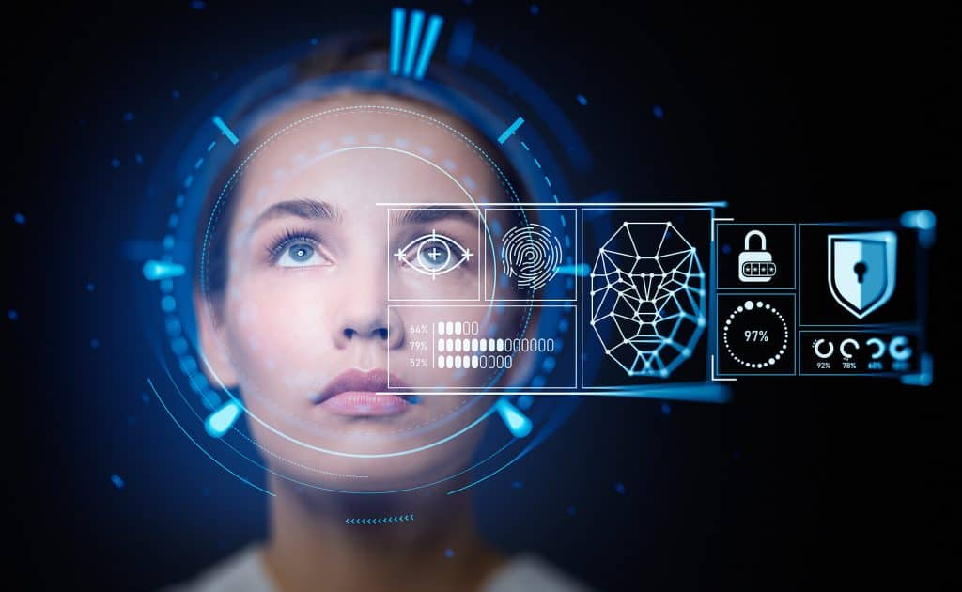
Problem Statement/Type of Work
We aim to develop an AI-based application that analyzes human facial expressions to detect emotions like happiness, sadness, anger, and more. Additionally, it will include features of aging and de-aging.
The system will provide a percentage breakdown of each emotion, helping users quickly understand their feelings.

Slide 3
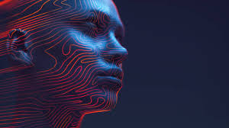
Background
In 1960, Bledsoe created a face recognition system that only recognized images.
Advances in AI led to the development of algorithms for emotion recognition.
Modern systems can identify both faces and emotions, with applications in various fields like security and healthcare.

Slide 4
Existing Systems
App | Features | Weakness
1. Affectiva[2] | Detects 5 emotions (anger, joy, sadness, surprise, fear, etc.) Measures overall sentiment and emotional intensity | Accuracy may decrease in low-light conditions or with hidden faces. Requires high-quality video input for best results.
2. Face Reader[1] | Detects basic emotions (happy, sad, angry, surprised) Recognizes neutral expressions | Limited ability to detect complex emotions. Less effective for individuals with atypical facial expressions or features
3. RealEyes[5] | Applies real-time visual effects, face aging/de-aging Analyzes facial features to estimate age, gender, or ethnicity. | The app’s performance could be heavily reliant on the quality of the user’s camera. Face recognition and demographic identification may not be 100% accurate

Slide 5
Our App Features
 | Features
AI-Driven Face Analysis | Our app detect 9 emotions (happy, sad, depressed, anxiety, disgusting, fear, confused, surprise, angry). Provides percentage values for how strongly an emotion is expressed (e.g., 70% happy, 30% surprised).
 | AI can provide insights into demographic categories for targeted marketing or personalization. Clears blurry or unclear images due to light effects before providing facial expression analysis.
 | Simulate how a person’s face might change over time, either by aging (making a face look older) or de-aging (making a face look younger).

Slide 6
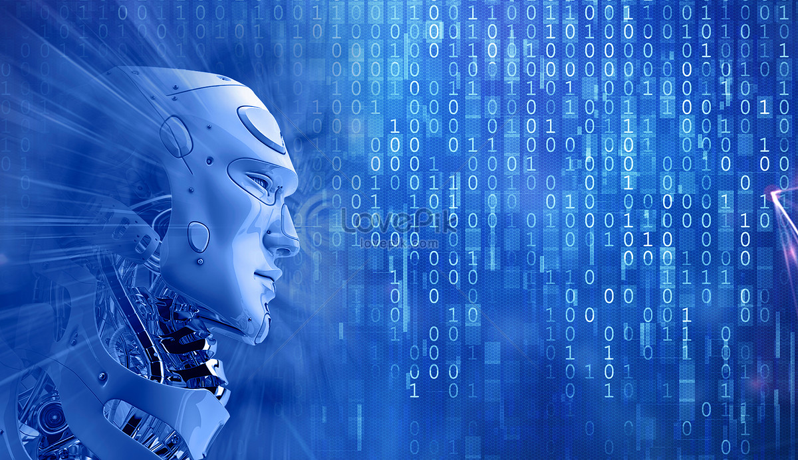
Business Scope
1. Healthcare
Early detection of mental health conditions like depression and anxiety.
Help in monitoring patient well-being.
2. Education
Enables automated attendance and identification.
3. Missing Person
Uses aging and de-aging to identify individuals found years after going missing,
Such as a child lost and found after year’s.
4. Security
Identifies disguised individuals entering secure areas (e.g., banks)

Slide 7

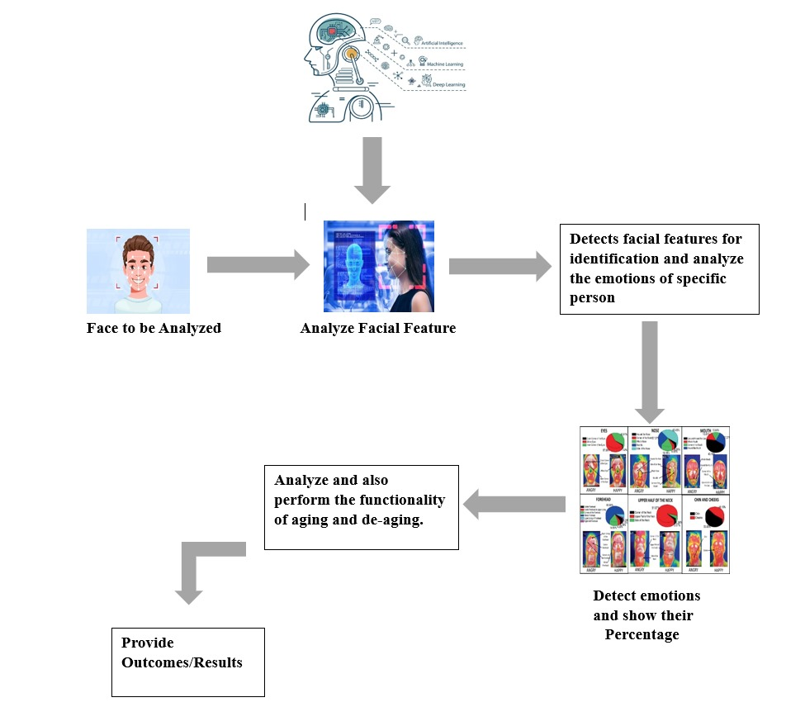
Methodology/Framework

Slide 8
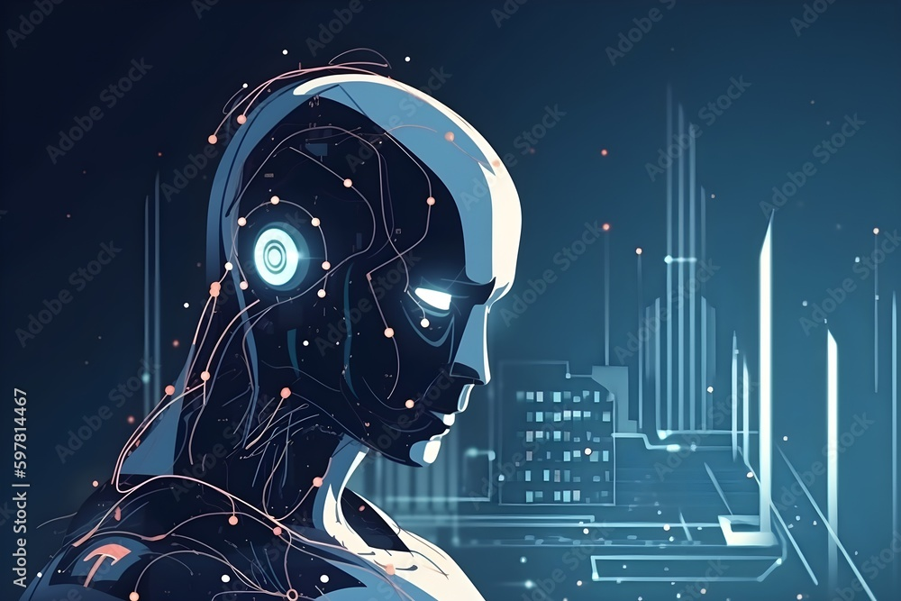
Tools and Languages
1. Development Environment:
We are using Android Studio as our development environment.
It is easy to install, user-friendly, and offers a variety of tools and options.
2. Language
We are using Python for our app development.
It has extensive libraries, simple and readable syntax and large developer community.

Slide 9
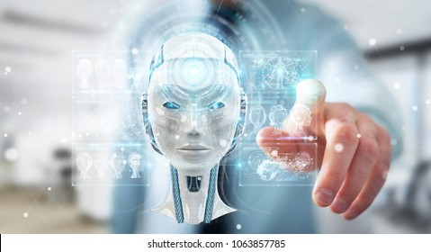
Constraints and Limitation
1. Accuracy and Reliability
While AI face analysis technology has improved, it is not infallible.
But factors like angles, and facial obstructions (e.g., masks, glasses) can impact the accuracy.
2. Ethical Concerns
Concerns arise regarding surveillance, consent, and the potential for its misuse by Government or Corporations.

Slide 10
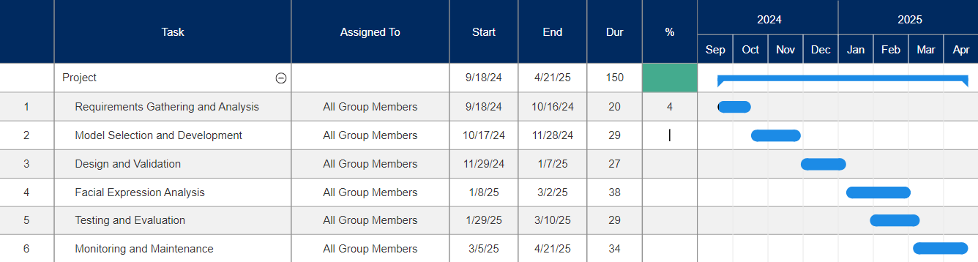
Work breakdown with timelines

Slide 11
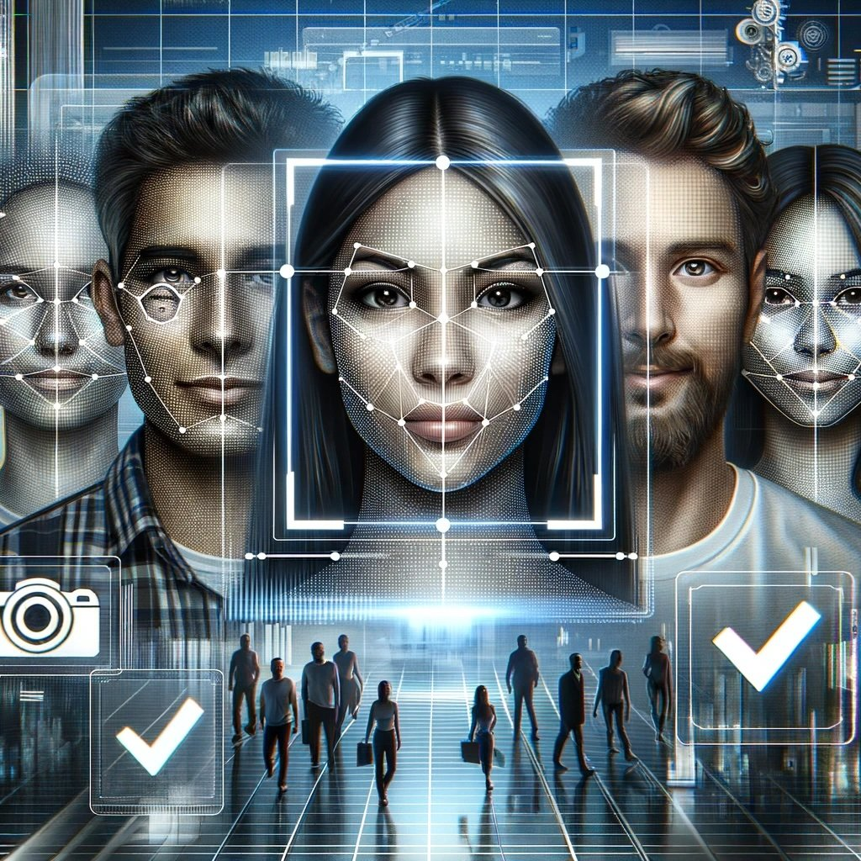
Conclusion
AI-driven face analysis has rapidly evolved from basic facial recognition
At the company level, it offers immense potential for security protocols, and making data-driven decisions based on emotional insights.
As AI technology continues to advance, the capabilities of face analysis will only expand.
Making itself an essential tool for businesses seeking to stay competitive in an increasingly digital world.

Slide 12
References
Naga, P., Marri, S. D., & Borreo, R. (2023). Facial emotion recognition methods, datasets and technologies: A literature survey. Materials Today: Proceedings, 80, 2824-2828.
Peng, Z., Fu, R. Z., Chen, H. P., Takahashi, K., Tanioka, Y., & Roy, D. (2024). AI Applications in Emotion Recognition: A Bibliometric Analysis. In SHS Web of Conferences (Vol. 194, p. 03005). EDP Sciences.
Tomášik, J., Zsoldos, M., Majdáková, K., Fleischmann, A., Oravcová, Ľ., Sónak Ballová, D., & Thurzo, A. (2024). The Potential of AI-Powered Face Enhancement Technologies in Face-Driven Orthodontic Treatment Planning. Applied Sciences, 14(17), 7837.
Girija, M., & Sampath Kumar, T. (2024). State of art on evaluation of three-to six-dimensional novel additive manufacturing technology for biomedical applications. Proceedings of the Institution of Mechanical Engineers, Part E: Journal of Process Mechanical Engineering, 09544089241281985.
Castellano, G., De Carolis, B., & Macchiarulo, N. (2023). Automatic facial emotion recognition at the COVID-19 pandemic time. Multimedia Tools and Applications, 82(9), 12751-12769.
Raju, R., & TR, P. A. (2024). Accuracy of Tooth Segmentation in the Digital Kesling Setup of Two Different Software Programs: A Retrospective Study. Cureus, 16(9).
Tomášik, J., Zsoldos, M., Oravcová, L., Lifková, M., Pavleová, G., Strunga, M., & Thurzo, A. (2024). AI and Face-Driven Orthodontics: A Scoping Review of Digital Advances in Diagnosis and Treatment Planning. planning, 5, 7.
Botta, A., Rotbei, S., Zinno, S., & Ventre, G. (2023). Cyber security of robots: A comprehensive survey. Intelligent Systems with Applications, 18, 200237.
Sham, A. H., Aktas, K., Rizhinashvili, D., Kuklianov, D., Alisinanoglu, F., Ofodile, I., ... & Anbarjafari, G. (2023). Ethical AI in facial expression analysis: racial bias. Signal, Image and Video Processing, 17(2), 399-406.
Gupta, S., Modgil, S., Lee, C. K., & Sivarajah, U. (2023). The future is yesterday: Use of AI-driven facial recognition to enhance value in the travel and tourism industry. Information Systems Frontiers, 25(3), 1179-1195.

Slide 13
